Slide 1
Unraveling the Mechanism of a Metacognitive Intervention: Probing the Influence of Feedback-viewing Behavior on Exam Performance
Sydney Y Wood & Victoria Cross
University of California Davis

Slide 2
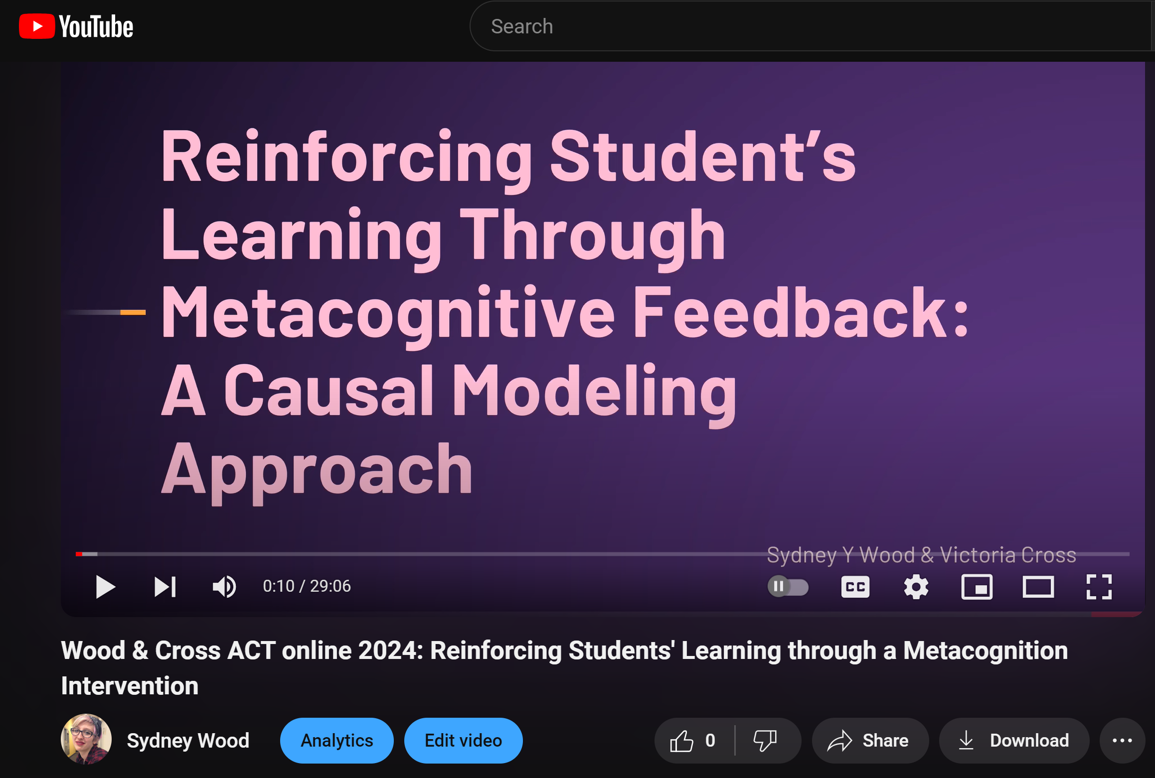
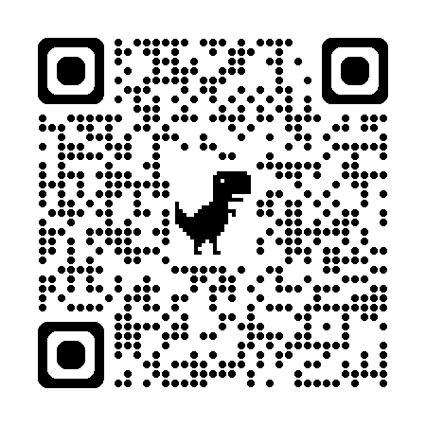
Metacognitive Exam Corrections Study (Wood & Cross, 2024)
Background

Slide 3
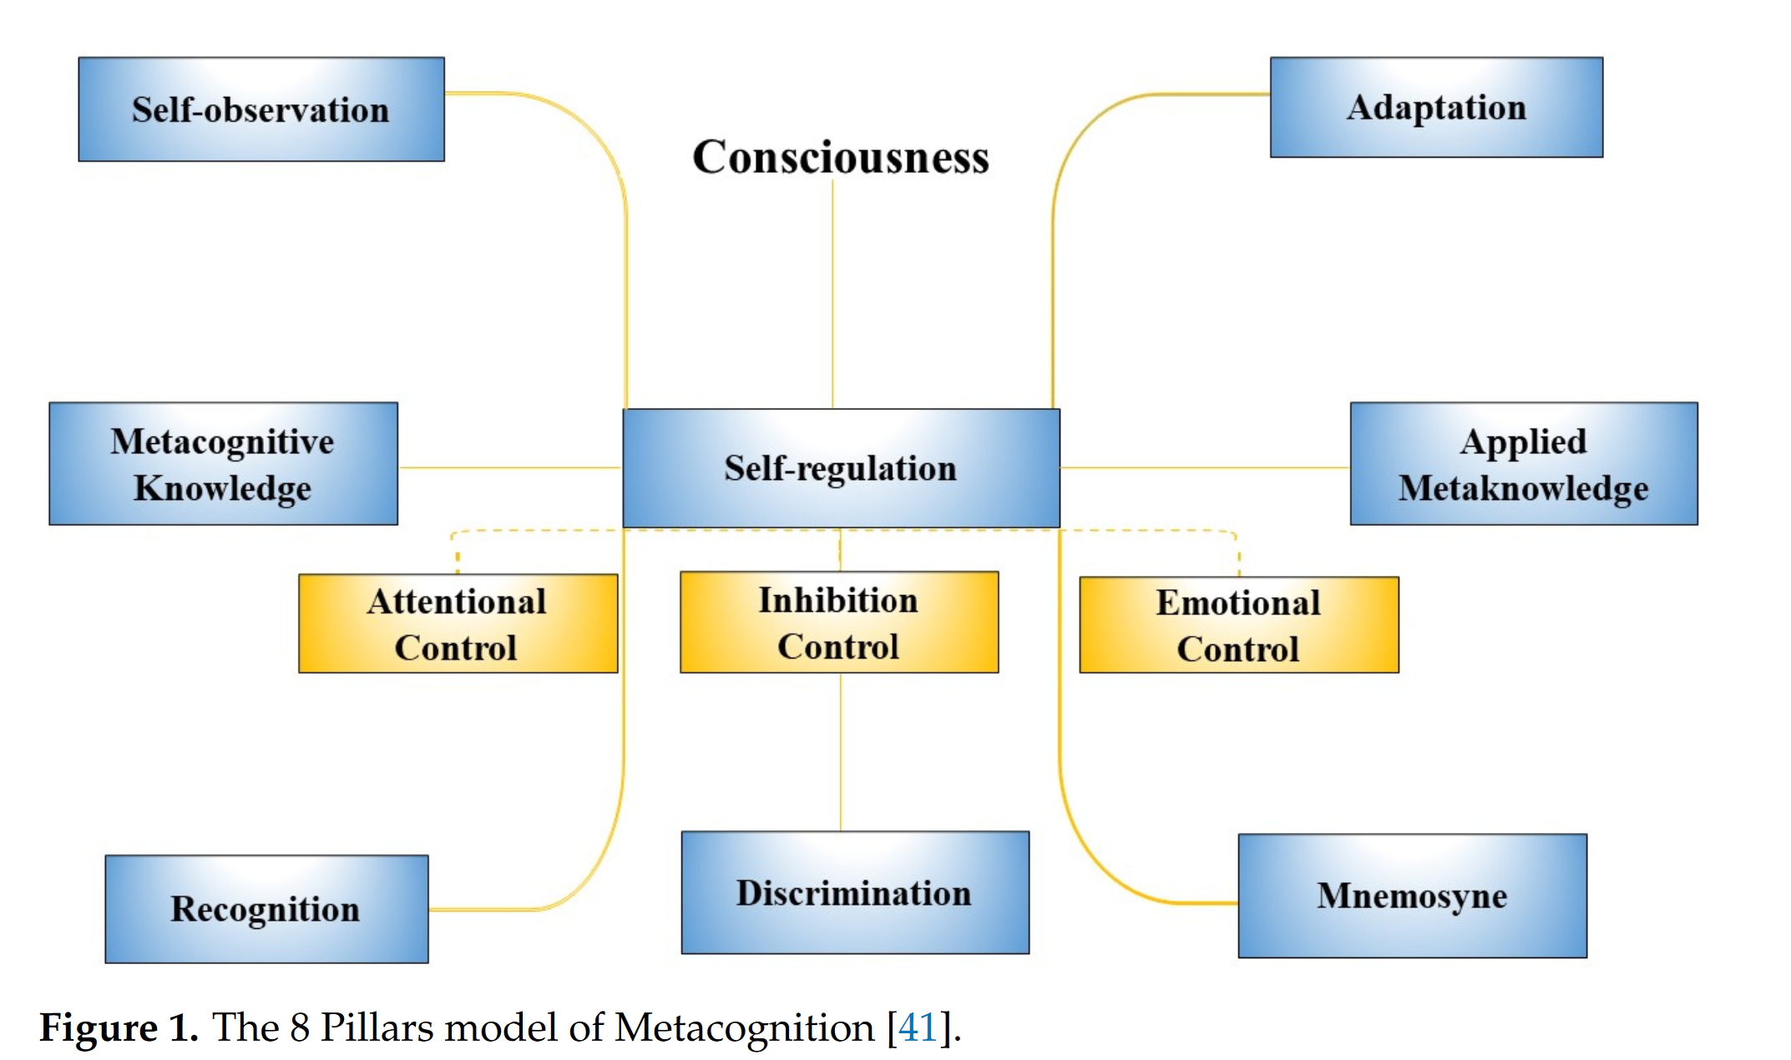
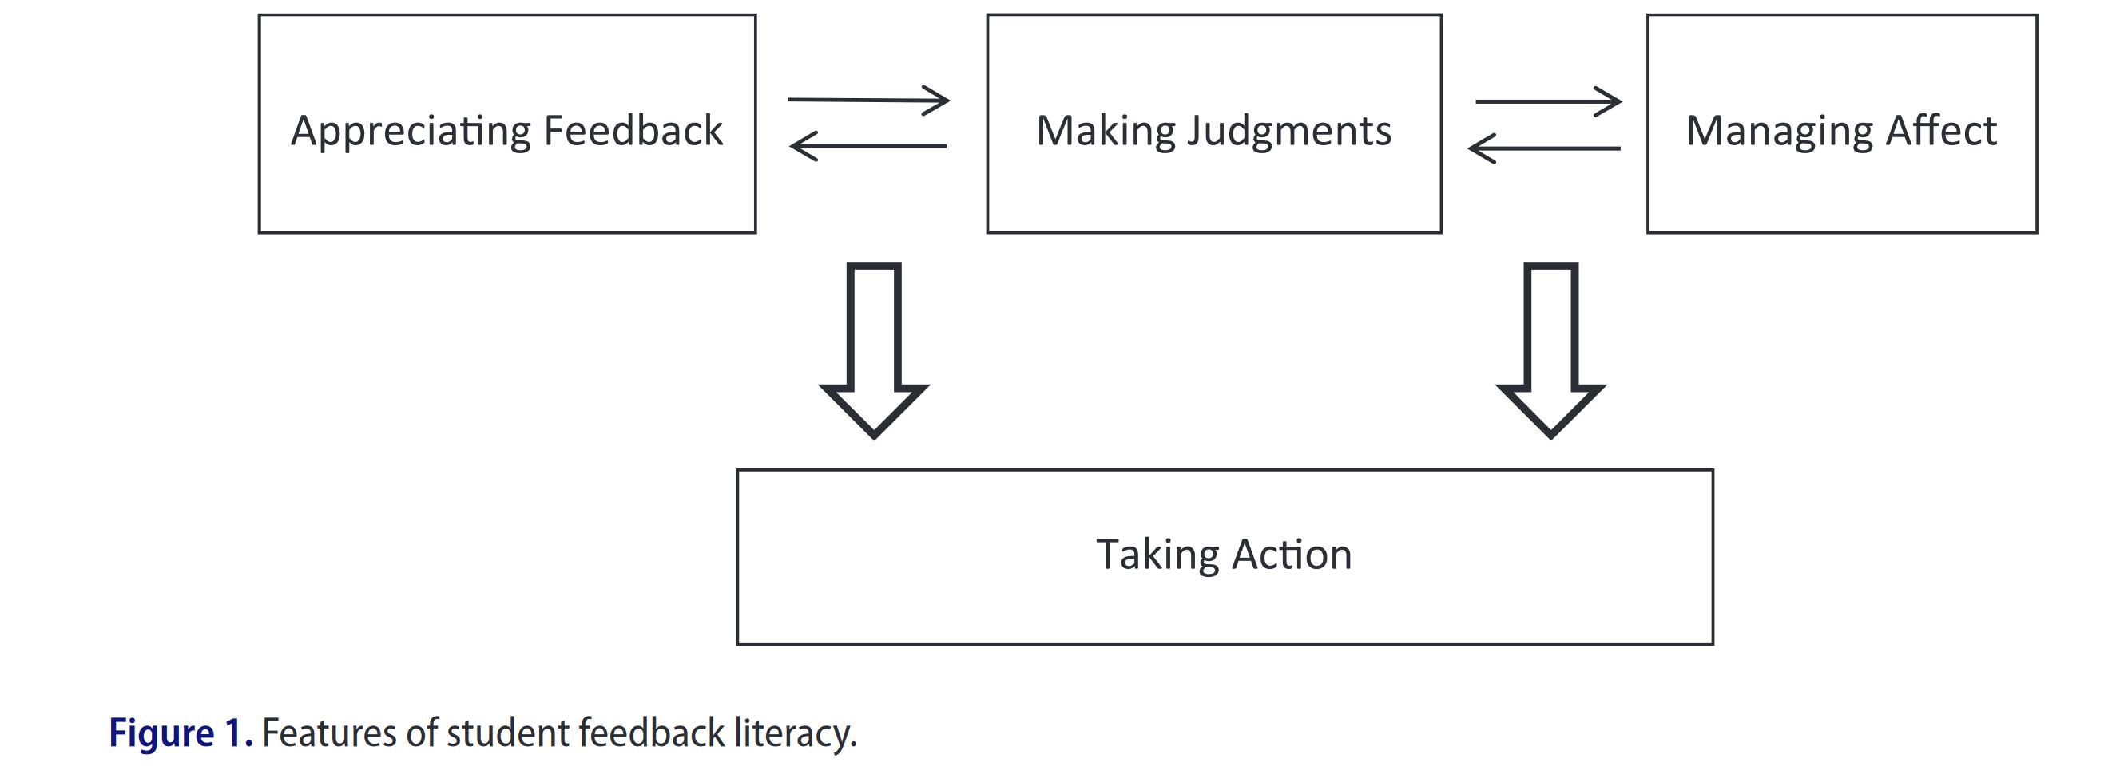
Metacognitive Engagement with Feedback
(Drigas et al., 2023)
(Carless & Boud, 2018)
Background

Slide 4
The Intervention (Wood & Cross, 2024)
Prompting Metacognitive Awareness through videos and instruction
(Drigas et al., 2023)
Background

Slide 5
The Intervention (Wood & Cross, 2024)
Prompting Self-regulation through reflective writing prompt in the cover letter
(Drigas et al., 2023)
Background

Slide 6
The Intervention (Wood & Cross, 2024)
Prompting Adaptation through written exam corrections
(Drigas et al., 2023)
Background

Slide 7
Results (Wood & Cross, 2024)
Series of 8 nested Structural Equation Models
Inherent group differences are insufficient to explain the change in trajectory
The intervention increased exam performance
Background

Slide 8
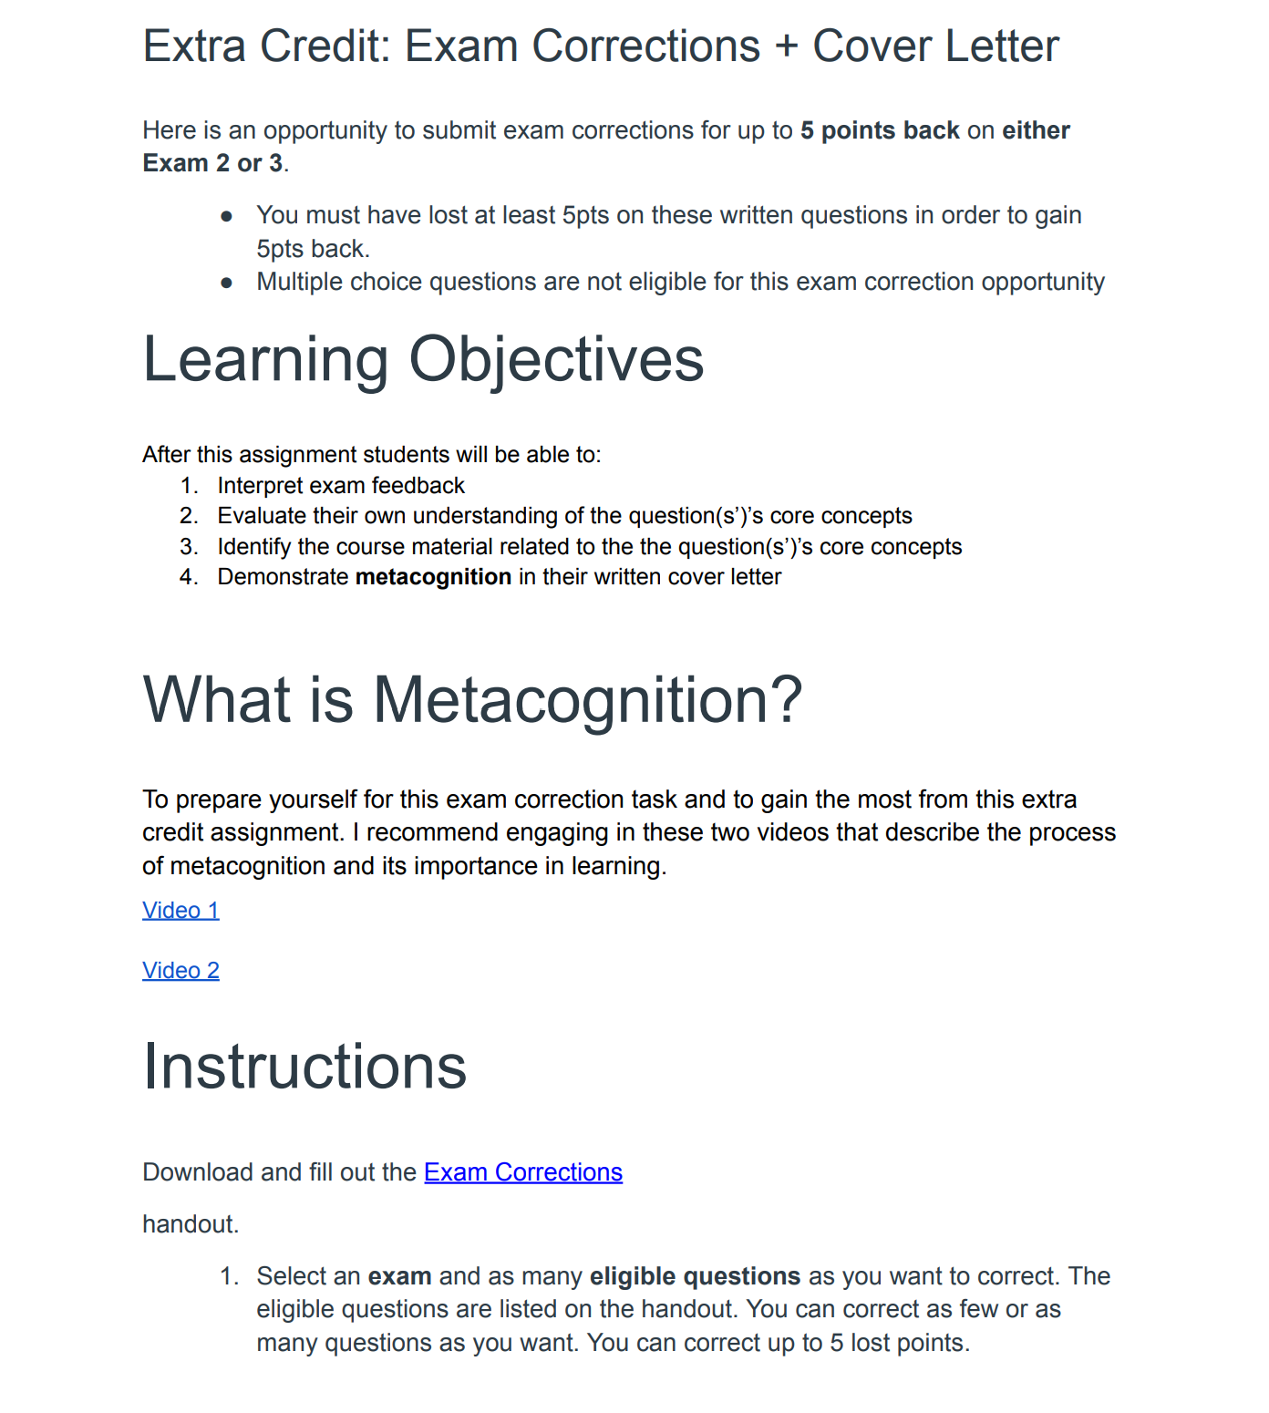
Implemented Mechanisms
Assessment scaffolding
Research-informed feedback
Exam wrapper
Short answer exam corrections
Reflective writing
Cover letter
Background

Slide 9
What mechanism drives the impact of the intervention?
Can increased feedback viewing explain the observed change in performance?
Current Study

Slide 10
Data
Sample
370 students at a public R1 university
190 opted in to the intervention
180 opted out of the intervention
Variables
Data

Slide 11
Data
Sample
Variables
Exam Performance
5 exams
Written responses
View Count
Intervention Group
Data

Slide 12
Data
Sample
Variables
Exam Performance
View Count:
Number of times feedback was viewed
Collected morning of subsequent exam
4 observations
Intervention Group
Data

Slide 13
Data
Sample
Variables
Exam Performance
View Count
Intervention Group
Opt-in vs Opt-out
Data

Slide 14
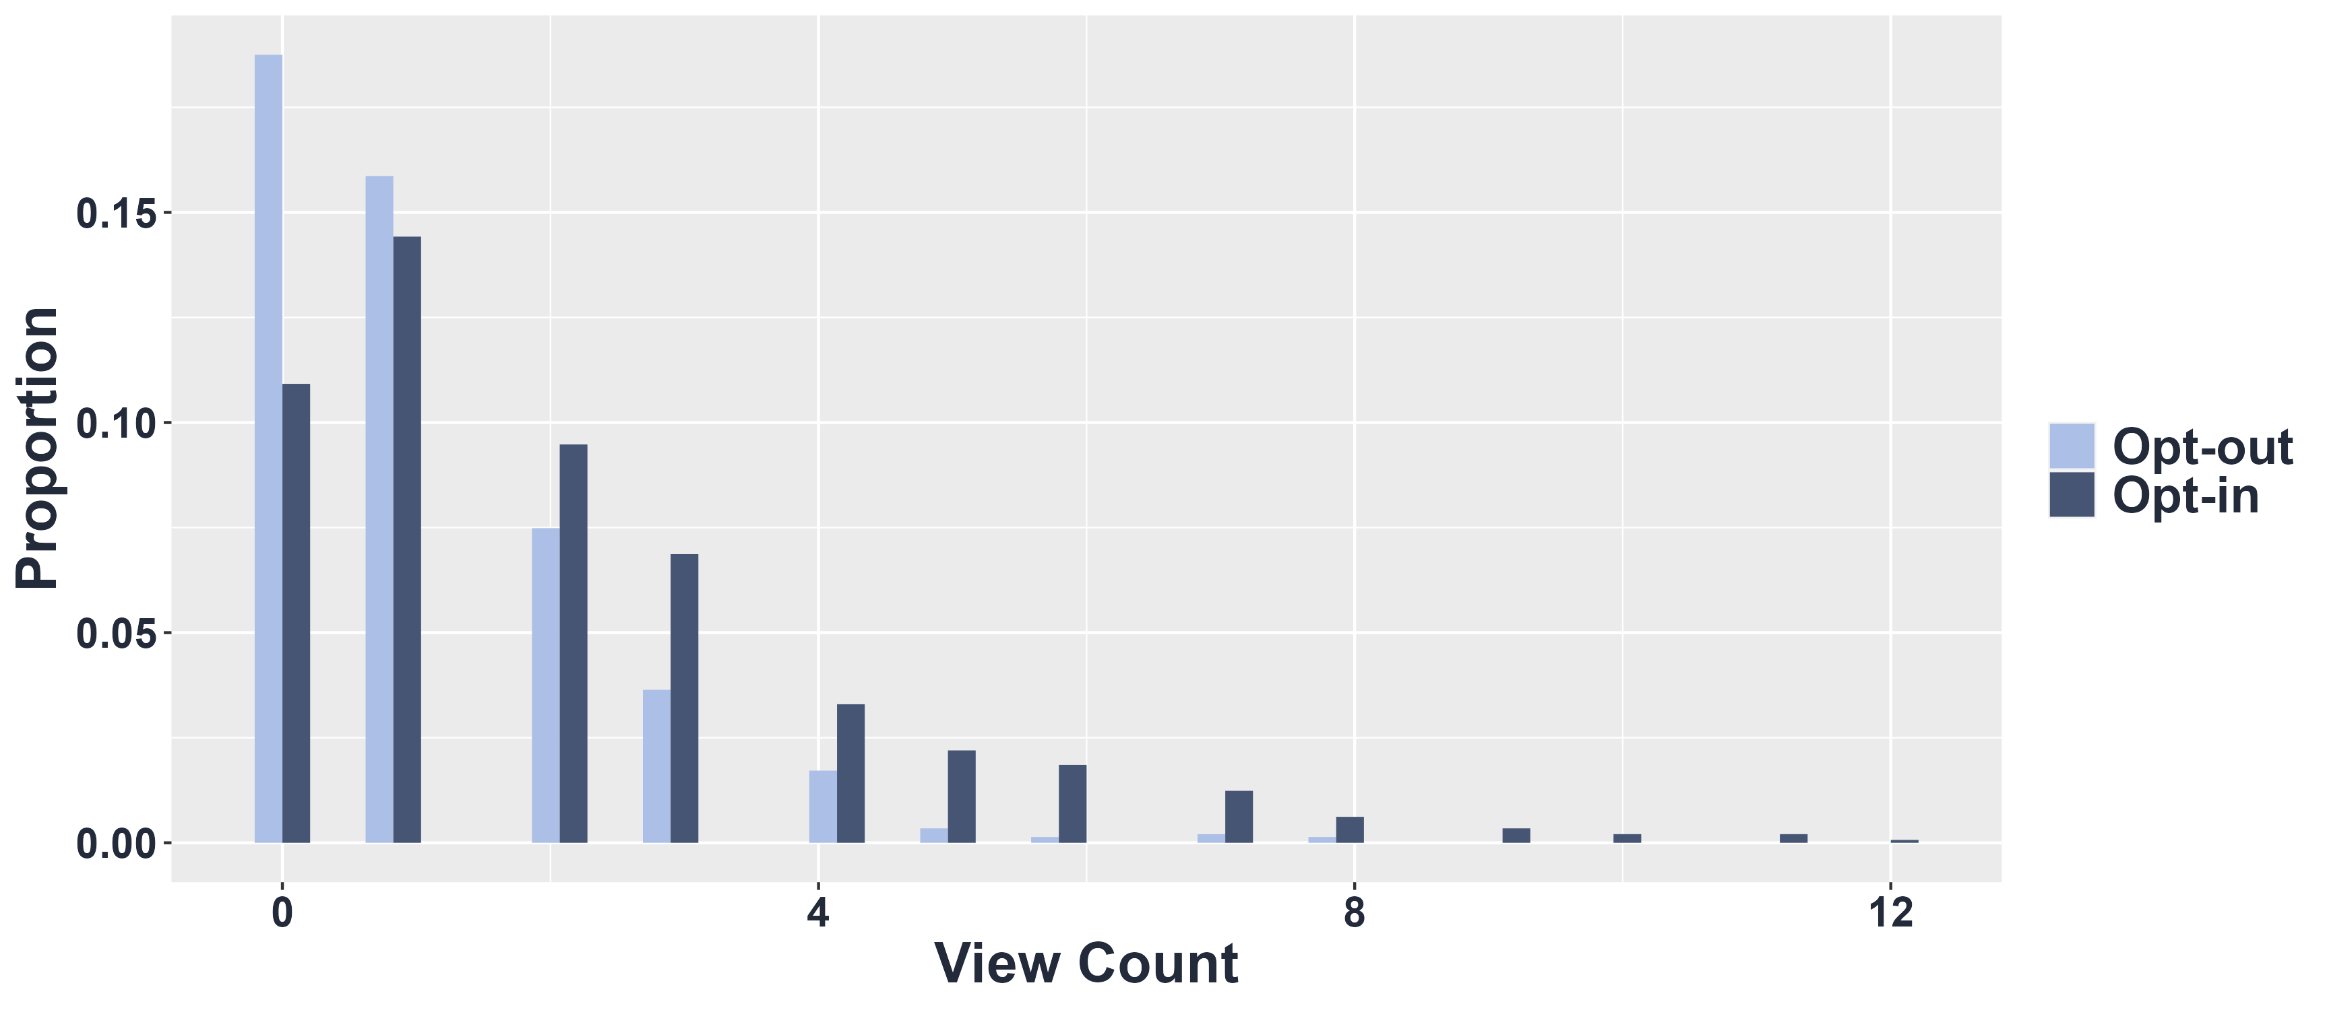
Difference in View Count by Intervention Group
Results

Slide 15
Difference in Difference of Feedback Viewing Behavior Over Time by Intervention Group
=========================================
Dependent variable:
---------------------------------------------
View Count
---------------------------------------------------------------
Time 2 -0.210528**
(0.094130)
Time 3 0.047843
(0.093660)
Time 4 -0.153503
(0.101803)
Diff Time 2 0.100591
(0.121855)
Diff Time 3 0.589448***
(0.118219)
Diff Time 4 0.087878
(0.140608)
---------------------------------------------------------------
Observations 1,456
Log Likelihood -1,837.351000
Akaike Inf. Crit. 4,426.702000
========================================
Note: *p<0.1; **p<0.05; ***p<0.01
cluster Robust standard errors in parentheses
Time 1 is between Exam 1 & 2
Time 2 is between 2 & 3
Time 3 is between 3 & 4- during the intervention
Time 4 is between 4 & 5 – only post-intervention observation
Results

Slide 16
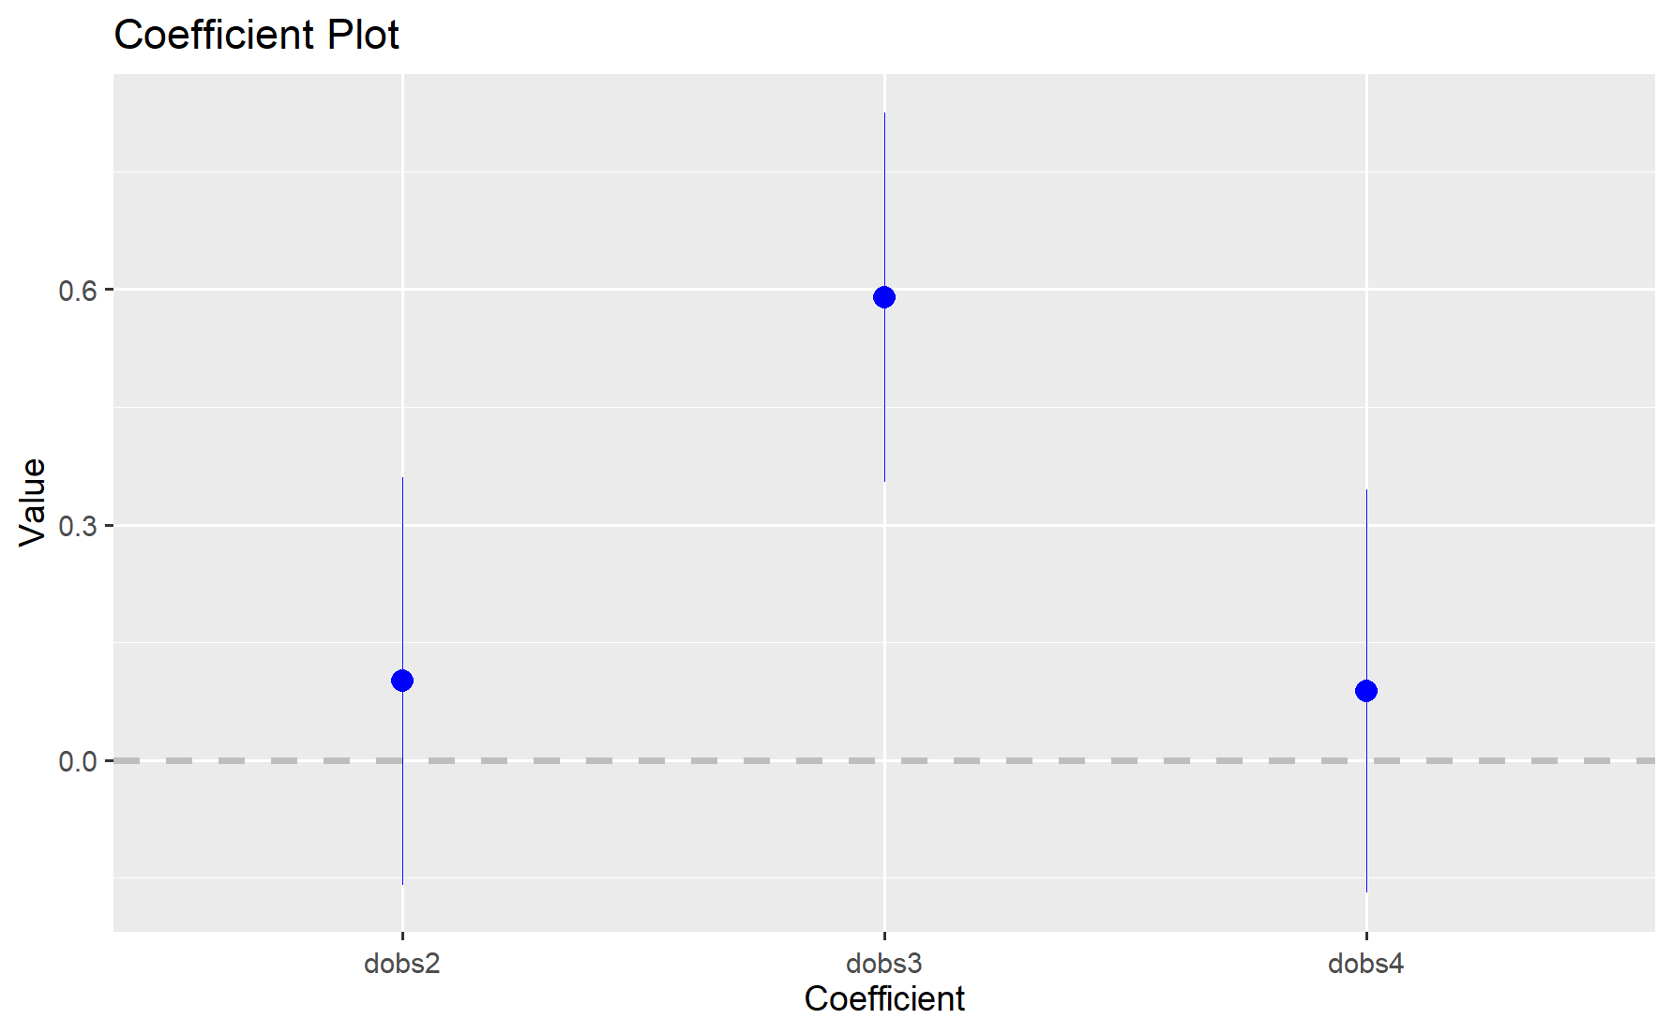
Difference in Difference of Feedback Viewing Behavior Over Time by Intervention Group
=========================================
Dependent variable:
---------------------------------------------
View Count
---------------------------------------------------------------
Time 2 -0.210528**
(0.094130)
Time 3 0.047843
(0.093660)
Time 4 -0.153503
(0.101803)
Diff Time 2 0.100591
(0.121855)
Diff Time 3 0.589448***
(0.118219)
Diff Time 4 0.087878
(0.140608)
---------------------------------------------------------------
Observations 1,456
Log Likelihood -1,837.351000
Akaike Inf. Crit. 4,426.702000
========================================
Note: *p<0.1; **p<0.05; ***p<0.01
cluster Robust standard errors in parentheses
Diff Time # is the difference in feedback view count by intervention group at time #
Diff Time 2
Diff Time 3
Results
Diff Time 4

Slide 17
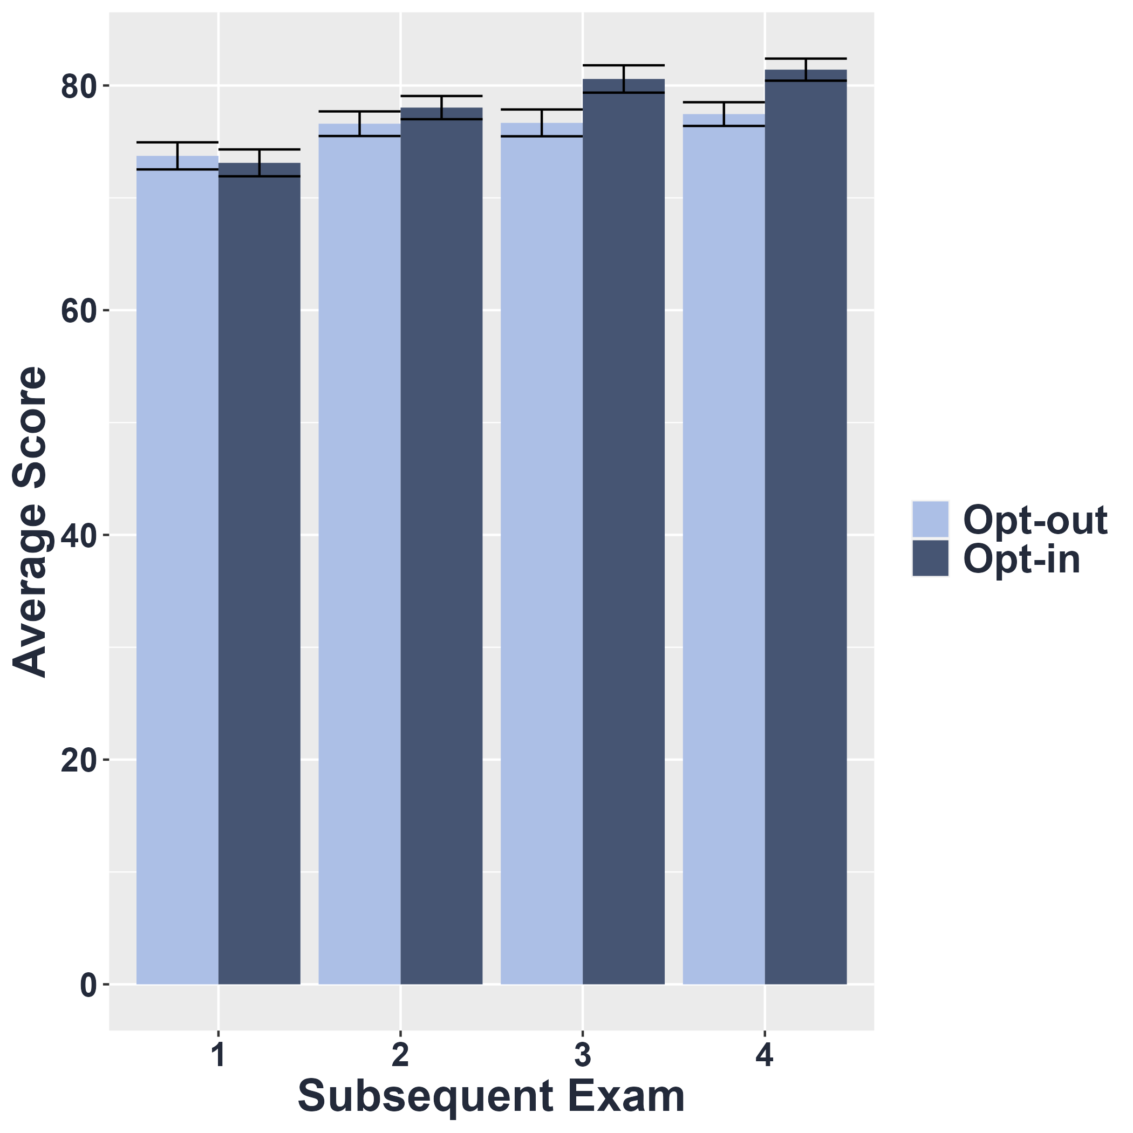
Performance on Exams
Consistent with the SEM:
Only differences in performance post-intervention
Exam2 Exam3 Exam4 Exam 5
Results

Slide 18
Does feedback viewing behavior predict performance on subsequent exams?
Results

Slide 19
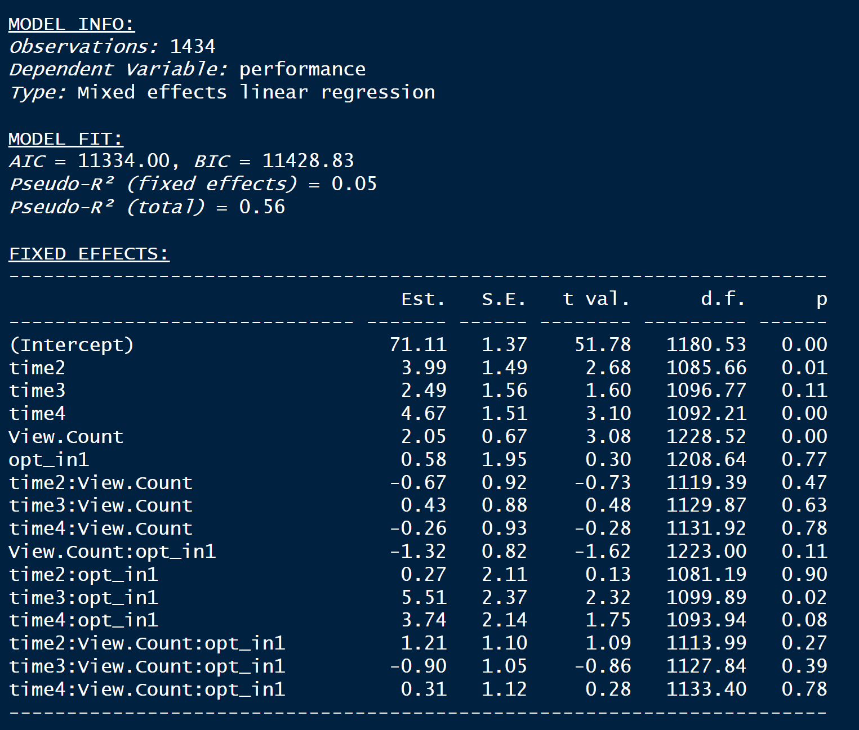
Linear Mixed-Effects Model with Groups
Controlling for feedback viewing (View Count) and Group: Performance steadily increased but not significantly for Exam 4
Results

Slide 20
Linear Mixed-Effects Model with Groups
Controlling for Time and Group: feedback viewing behavior predicted higher performance
Results

Slide 21
Linear Mixed-Effects Model with Groups
The effect of feedback viewing behavior did not depend on the exam number
Results

Slide 22
Linear Mixed-Effects Model with Groups
The effect of feedback viewing did not depend on Group
Results

Slide 23
Linear Mixed-Effects Model with Groups
Consistent with SEM: The opt-in group only saw an increase in performance immediately after the intervention (Time 3)
Results

Slide 24
Linear Mixed-Effects Model with Groups
No three-way interaction with Time, View Count and Group, suggesting that it was Group alone fueling the change in performance after the intervention
Results

Slide 25
The change in performance was not JUST because they looked at their feedback!
These results further support the causal interpretation in Wood & Cross, 2024
Take-away!

Slide 26
Acknowledgements
Undergraduate RAs
Collaborator
Victoria L Cross, UC Davis
Methods and Coding Consulting
Rohit Batra
Simran Johal
Dylan Hawksworth-Lutzow
Mjike Rhemtulla
Oliver Xia
Dani Lindeman
Esmeralda Barragan-Martinez
Laila Lawson
Marie Trumm
Valeria Gonzalez
Jamie Serrano
Jazmyne Newman
Bradford Martin
Nicholas Silva
Olivia Yoder

Slide 27
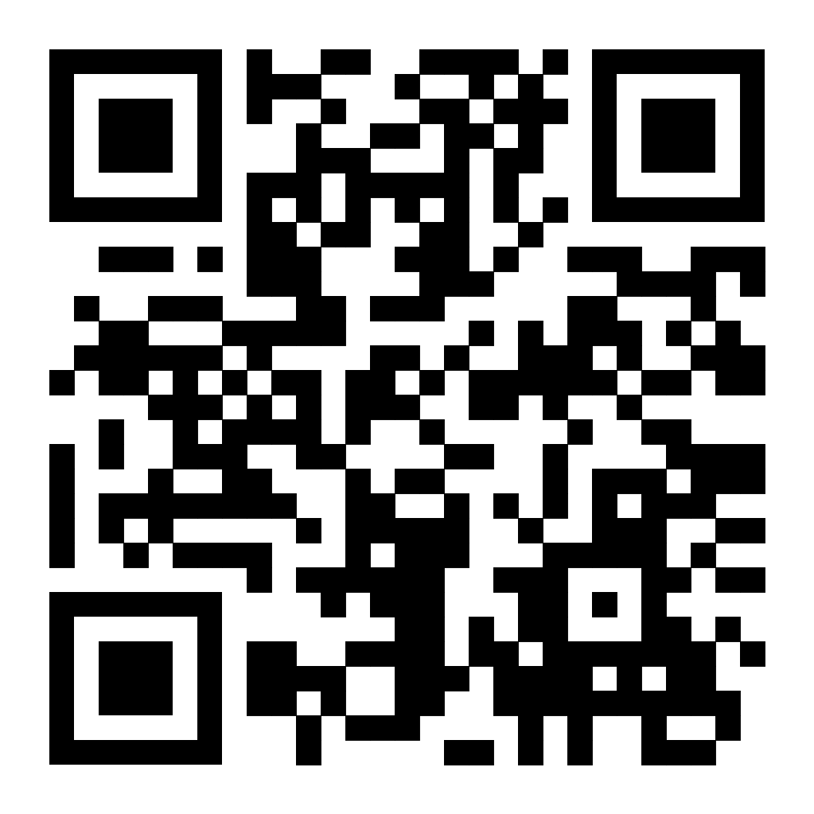
Pre-print, Contact info & More

